Slide 1
Machine Learning Project EEG Classification for active touch activity
Students: Chaitali Pawar and Haneen Alsuradi
Net IDs: csp431 and hha243
Spring 2019

Slide 2
Experiment Background
Study the neural activation of an active touch task with and without tactile feedback.
The touch task is performed on (Tanvas) tablet that is capable of providing tactile feedback.
The touch task is moving the index finger on a virtual guitar’s string with two conditions: with or without tactile feedback.

Slide 3
Formulation
N= 24 subjects
C= 58 channels
F= 55 frequency bins [55 Power Spectral Density plots per channel]
T= 70 data points per channel per band
W= 2 conditions (with or without tactile feedback)
Tr= 96 trials of EEG per condition
Target variable: Y→ (0,1)
Predict from the EEG data whether tactile feedback was present or not

Slide 4

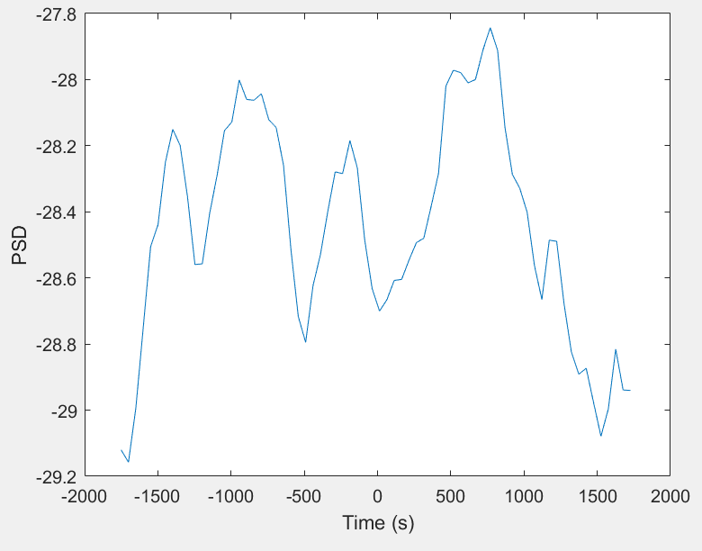

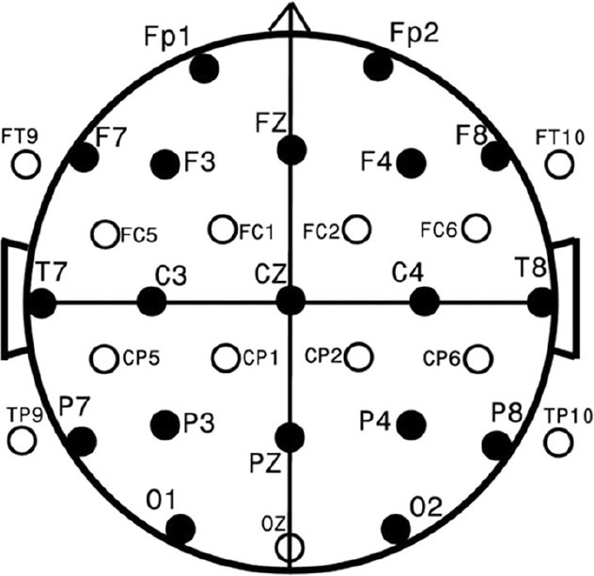
Formulation
X 55 plots
24 Subjects
2 conditions.
Each is repeated 96 times per subject
70
data points
58 channels

Slide 5
Approach
Data preparation:
From the 55 frequency bins, the power spectral densities across 4 frequency bands were computed:
Theta (4 - 7Hz)
Alpha(8-12 Hz)
Beta (13 -30Hz)
Gamma(31-50Hz)
So, for each subject, we have EEG recordings for:
Two conditions (w,w/o), 4 Frequency bands, 58 channels, 96 trial per condition.

Slide 6
Approach
Approach 1: Single Trial Classification
Input matrix: 4416 by 70 [96 trials *23 subjects *2 conditions by 70 features]
Each frequency band and each channel was trained separately.
Classification methods:
Logistic Regression with L2 → Found optimized C
SVM with RBF kernel → Less sensitive to C and gamma variation
Approach 2: Averaged Trials Classification
Input Matrix is 48 by 70 [24 subjects *2 conditions by 70 features]
Each frequency band and each channel was trained separately.
Baseline Correction is implemented.
Classification methods:
SVM with RBF kernel → Less sensitive to C and gamma variation

Slide 7
Analysis
Approach 1:
Alpha and theta band are not useful for classification as their accuracies are low and the best performing channels do not repeat over re-runs.
For beta band, the best scaling method was -1 to +1 normalization .
For gamma band, the best scaling method was StandardScaler().
Best Accuracy is 55% for beta band
Best channels for beta band i.e the ones that exhibit higher accuracy are : 34,30,31
Best Accuracy for gamma band is 56%.
Best channels for gamma band i.e the ones that exhibit higher accuracy are : 39,23,8

Slide 8
Analysis
Approach 2:
Alpha and theta band are not useful for classification as their accuracies are low and the best performing channels do not repeat.
For beta band the best scaling metric was no scaling.
For gamma band the best scaling method was no scaling.
Best Accuracy is 64% for beta band.
Best channels for beta band i.e the ones that exhibit higher accuracy are : 34,30,31
Best Accuracy for gamma band is 56%.
Best channels for gamma band i.e the ones that exhibit higher accuracy are : 39,23,8

Slide 9
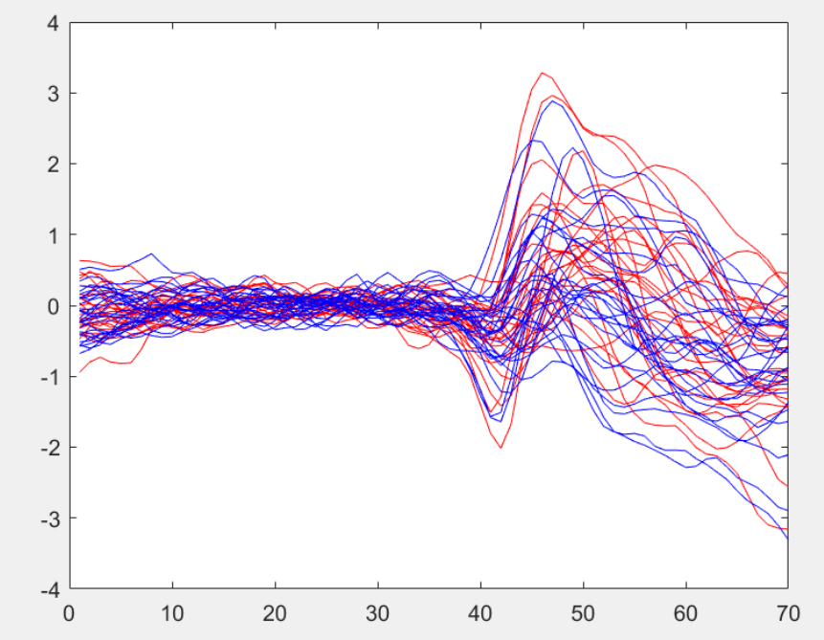
Analysis
The classification accuracy is low due to the challenging nature of the data [High Variability within the class]
An example from channel 30, beta band, which is one of the top performing channels:
With Tactile Feedback
Without Tactile Feedback
Power Spectral Density
Start of the task
Time Index

Slide 10
Analysis
From the previous analysis it is evident that:
Approach 2 yields higher accuracy.
Because averaged trials have higher Signal to noise ratio and thus a better accuracy was expected.
Additionally, the research paper suggests that beta band provides relevant information for discriminating the two groups.
We select beta band and Gamma band along with approach 2 for further improving our classification accuracy.
We will also use 35 features moving forward.

Slide 11
Accuracy Boosting
We have done the following to boost our accuracy:
Consider approach 2 [Averaged trials], Beta band and Gamma band, and 35 features.
Implement voting decision between top performing channels
Use stratified K-Fold Cross-validation to arrange the data such that in every fold, each class comprises around half the instances

Slide 12
Accuracy Boosting
Voting Classifiers
Voting was done in 3 different ways and the accuracy was compared.
Collective prediction using the top 3 performing channels of beta band only.
Collective prediction using the top 2 performing channels of gamma band only.
Collective prediction of 1 & 2 combined.
The following average accuracies were reported across 5 folds for the above mentioned methods :
69.5%
62.5%
68%

Slide 13
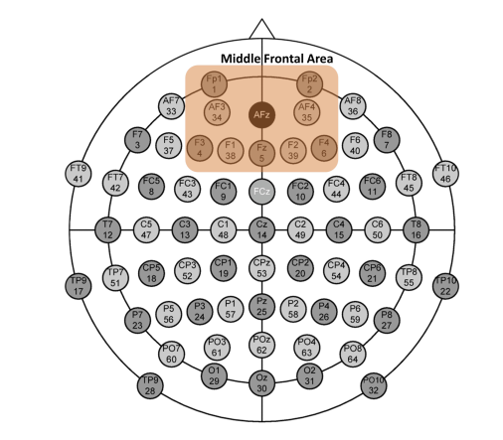
Conclusion
For an active touch task EEG classification, we recommend the following:
- Consider beta band for classification
- Channels 30 [AF3], 31 [Af4] and 34 [F1] are one of the best channels for classification (Middle-Frontal Area of the cortex)

Slide 14
Conclusion
For an active touch task EEG classification, we recommend the following:
- Using averaged trials for classification yields higher accuracies
- Using stratified k-fold cross-validation yields higher accuracies
- Using the features at the start of the active touch task onward is better than considering the pre-experiment features
- Implementing the voting classifiers between the top performing channels yields higher accuracy than considering a single channel
- The highest average accuracy that we report in this project is 69.5 %

